Slide 1
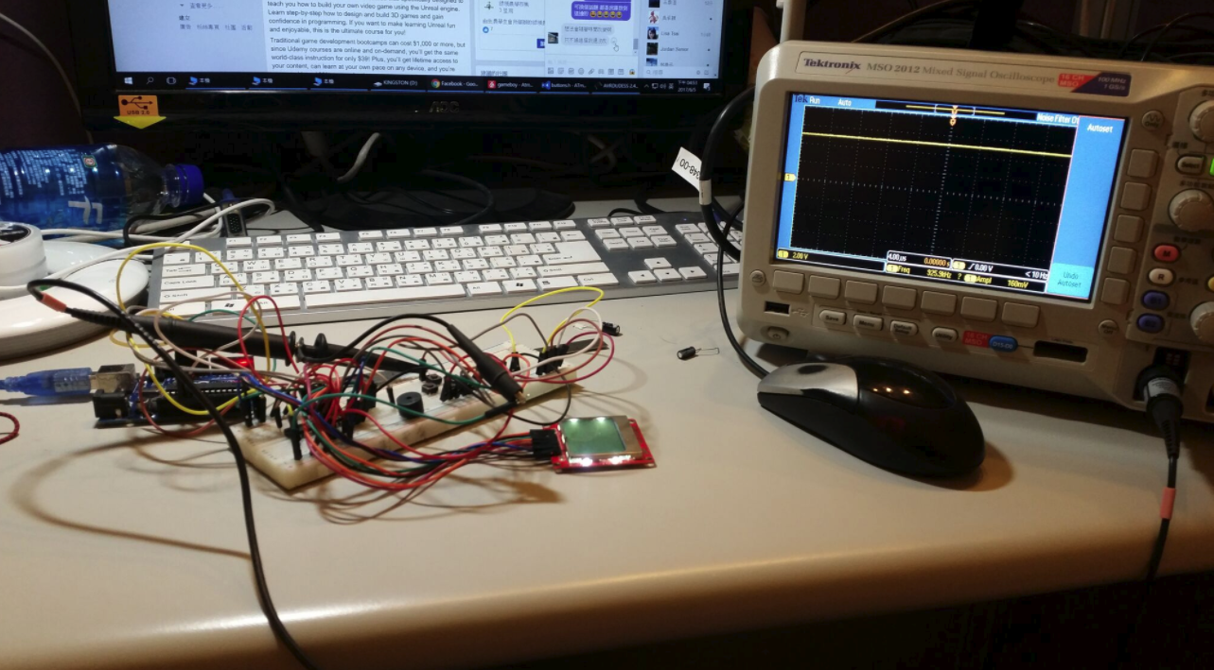
2017 MCU Final Project
Liu, An-Chi & Chang, Che-Yuan BIME, NTU

Slide 2
Handheld Game Console
We made a

Slide 3
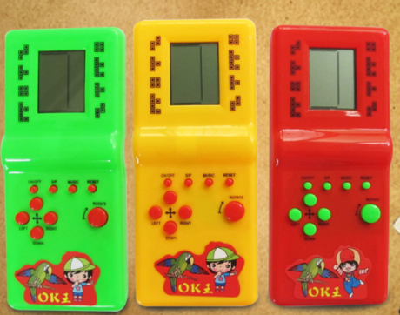
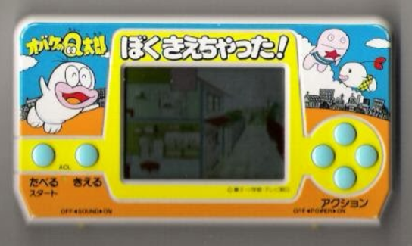
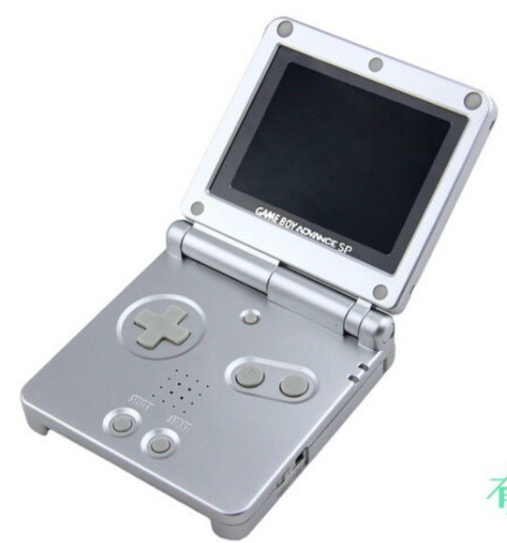
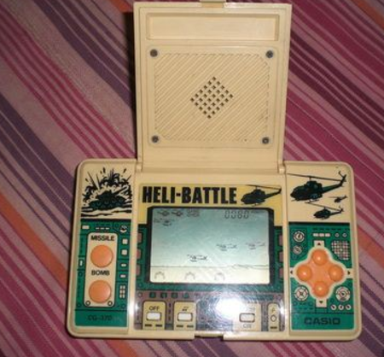

Slide 4
Components
MCU
LCD
Buttons
Others
Somewhere

Slide 5
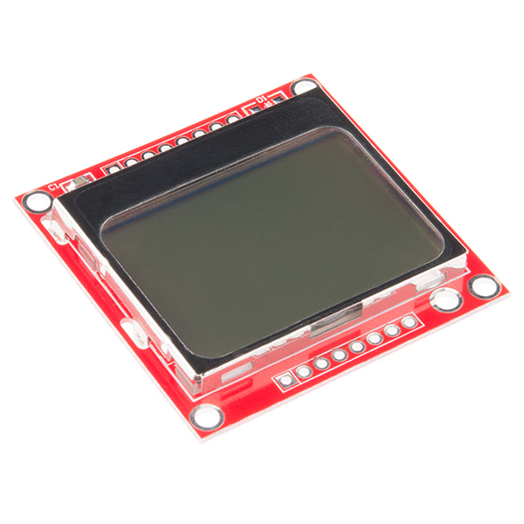
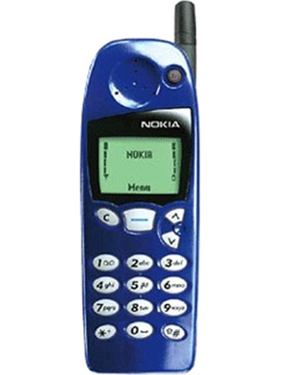
LCD
Nokia5110 LCD

Slide 6
Nokia5110
48 × 84 pixels matrix
PCD8544 Controller
CMOS
https://learn.sparkfun.com/tutorials/graphic-lcd-hookup-guide

